Slide 1
Generic programming
Function template

Slide 2
Conventional Approach
void printInt( int n )
{
cout << “The Value is " << n ;
}
void printChar( char ch )
{
cout << “The Value is " << ch ;
}
void printFloat( float x )
{
cout<<“The value is”<<x;
}
void printDouble( double d )
{
cout<<“The value is”<<d;
}
To output the traced values, we insert:
printInt(sum);
printChar(initial);
printFloat(angle);

Slide 3
Function overloading Approach
void Print( int n )
{
cout << “The Value is " << n ;
}
void Print( char ch )
{
cout << “The Value is " << ch ;
}
void Print( float x )
{
cout<<“The value is”<<x;
}
void Print( double d )
{
cout<<“The value is”<<d;
}
To output the traced values, we insert:
Print(someInt);
Print(someChar);
Print(someFloat);

Slide 4
Generic function Approach
template<class SomeType>
void Print( SomeType val )
{
cout << “The value is " << val ;
}
Template parameter
(class, user defined type, built-in types)
To output the traced values, we insert:
To output the traced values, we insert:
Template argument
Print<int>(sum);
Print<char>(initial);
Print<float>(angle);

Slide 5
What do you infer from the 3 approaches???
Compare all those approaches.

Slide 6
Approach-1(Conventional)
Create separate functions with unique names for each combination of data types
  Difficult to keep track of multiple function names
Approach-2(Function overloading)
    Eliminates the need to come up with many different names for identical tasks.
    Approach-3(Generic function)
    When the compiler instantiates a template, it substitutes the template argument for the template parameter throughout the function template.

Slide 7
Summary of Three Approaches
Conventional Approach
Different Function Definitions
Different Function Names
Function Overloading
Different Function Definitions
Same Function Name
Template Functions
One Function Definition (a function template)
Compiler Generates Individual Functions

Slide 8
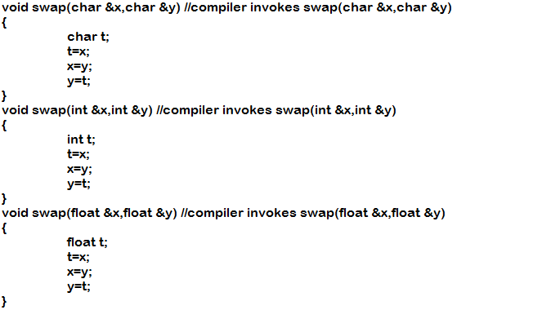
Example-2
How to perform the swapping on different data items?

Slide 9
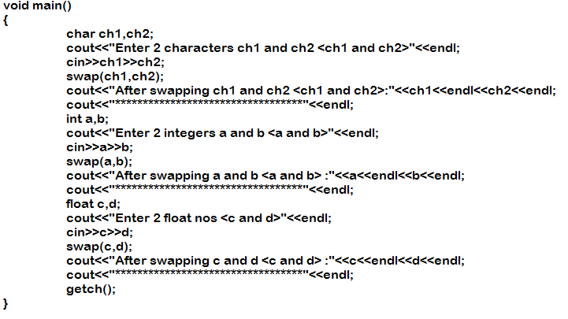

Slide 10
The above program performs well and is producing the output as well.
But it is less efficient. Because the same function “swap” is redefined by multiple times.
How to increase the efficiency of the above program?

Slide 11
Templates
Template is a kind of macro that supports the generic programming which allows to develop the reusable components.
It is one of the main features of object oriented language such as C++.
Actually, it allows the declaration of data items without specifying their exact data type. Two types: 1.Function template
2.Class template

Slide 12
Need of Function Templates
Reusability
Avoids the redefinition of function.
Describes a function format that when instantiated with particulars generates a function definition.
    Write once, use multiple times

Slide 13
Function Templates
Function templates are generic functions, which can operate on different data items.
C++ allows compiler to generate multiple versions of a function by allowing parameterized data types and hence it supports the parameterized polymorphism.
Data items are not declared while defining function
When the function call is made using appropriate data type, then the template function is transformed to operate on that specific data types

Slide 14
For example, if we want to invoke the function swap(), so we just supply the required data type parameters to it and the compiler automatically invokes the function template by defining the appropriate data items.
Therefore it allows a single “swap” with generic data type “T” to deal with multiple swap functions.

Slide 15
General syntax for function template:
The syntax of the function template is similar to normal function definition
template<class type>
returntype functionname(arguments)
{ …………..
statements;
……….
}

Slide 16
Guidelines to use the function template
No argument template function
template<class T>
T fun() //Error: T is not used as an argument
{
return n;
}
Template type argument unused
template<class T>
void test(int x) //Error: T is not used as an argument
{
T temp;
------
------
}

Slide 17
3.Usage of partial number of template arguments
template<class T, class U>
void fun(T &x) //Error: U is not used as an argument
{
U temp;
------
------
}

Slide 18
Overloaded Function Templates
The function template can also be overloaded with multiple declarations.
As similar to function overloading, the overloaded function templates must differ interms of number of parameters or their type.

Slide 19
Declaration of a function template for functions having multiple parameters of different types requires multiple generic arguments or template arguments

Slide 20
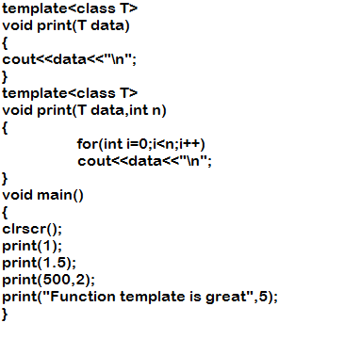
Example Program

Slide 21
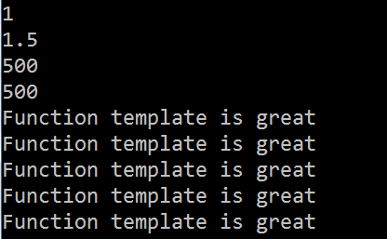

Slide 22
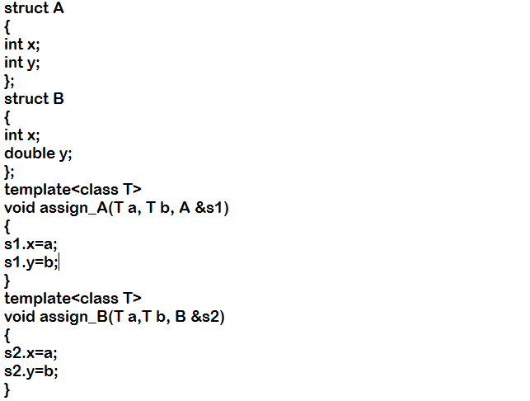
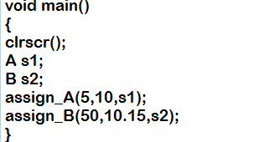
How to use multiple parameters in function template??

Slide 23
---continued
In main(), the statement assign_B(50,10.15,s2); leads to compilation errors.
Since, the above program is neither having the normal function nor function template ,matching with its parameters data type.
Therefore, the solution to the problem encountered in the above program is to declare the second template function in the above program as follows:

Slide 24
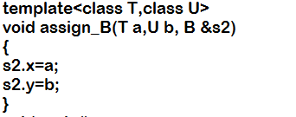
--continued
The declaration of the function template is the same, except that it has an extra argument in the template-argument-list, i.e class U.
This declaration informs the compiler that template function assign_B() with two arguments should be instantiated.
The compiler calls the appropriate instantiation. Any number of generic data types can be declared, provided all these generic data types are used in declaring formal parameters.

Slide 25
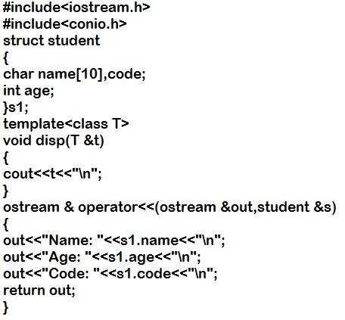
How to call the function template using user defined type

Slide 26
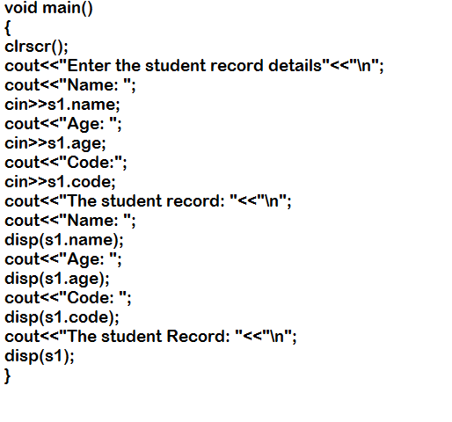

Slide 27
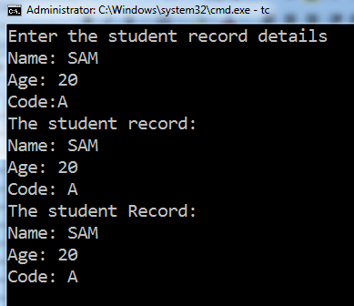

Slide 28
In Lab Practice problem
In a library, the books are arranged vertically in the rack, one above the other. The book(s) can be added or removed only from the top and not in the middle. You have been assigned to add 10 books and remove the books until the book rack is empty. Develop the program using generic function.

